Slide 1


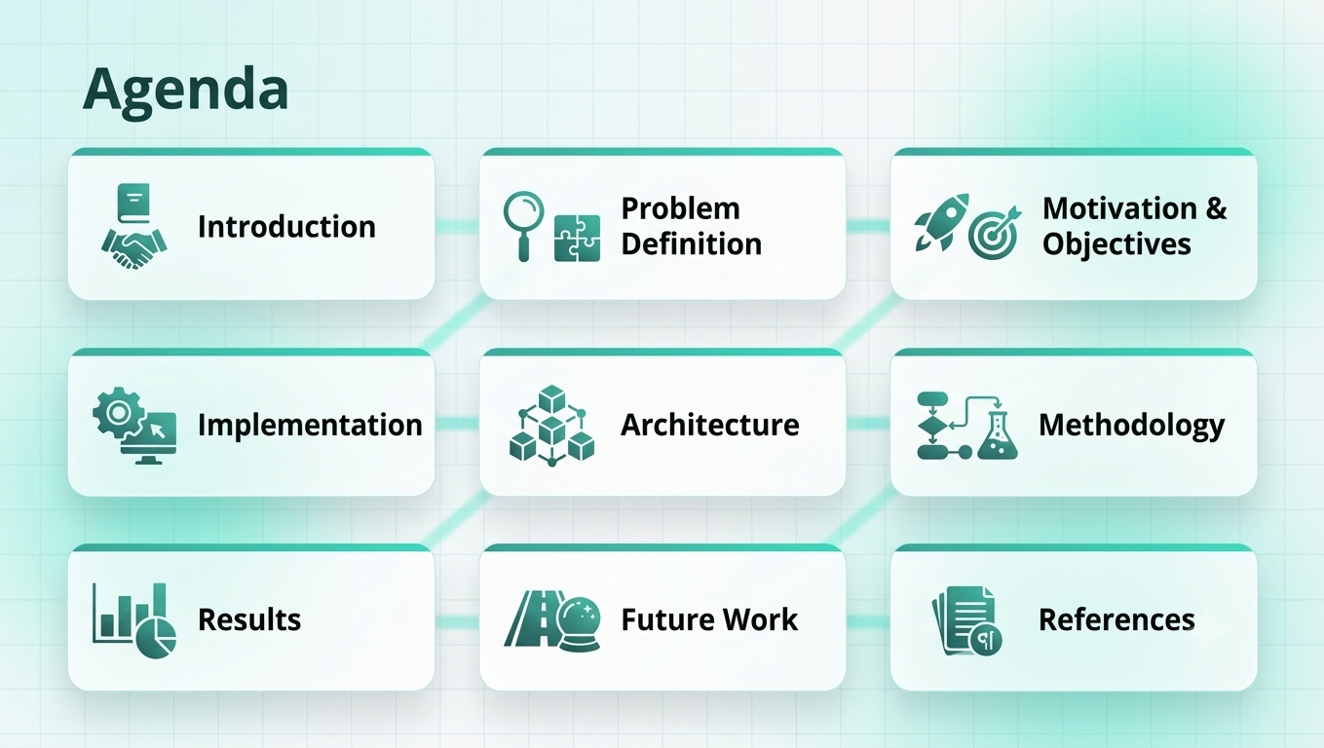

Slide 2


Agenda
Introduction
Problem Definition
Motivation & Objectives
Implementation
Architecture
Methodology
Results
Future Work
References
Introduction

Slide 3



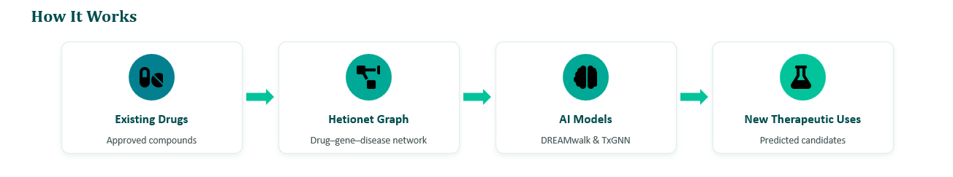
Introduction
Problem Definition
Motivation & Objectives
Implementation
Architecture
Methodology
Results
Future Work
References
Drug Repurposing Concept
Role of Artificial Intelligence
Using Knowledge Graphs
Drug repurposing aims to discover new therapeutic uses for existing drugs while traditional drug development
reducing the cost, time, and risks of
AI and deep learning techniques help
analyze large-scale biomedical data
and predict potential drug–disease
relationships efficiently.
The project utilizes biomedical datasets
as Hetionet Data to model complex biological relationships

Slide 4
Agenda
Introduction
Problem Definition
Motivation & Objectives
Implementation
Architecture
Methodology
Results
Future Work
References
Problem Definition

Slide 5
Introduction
Problem Definition
Motivation & Objectives
Implementation
Architecture
Methodology
Results
Future Work
References
Problem Definition
CHALLENGE
Why drug–disease prediction remains challenging in real-world biomedical data
1 Data incompleteness
2 Data heterogeneity
3 Model interpretability
Metapaths evaluated
1,206
Significant but unused
678
Final model features
5 US gov / open
31
755 known treatments
15 Permissive license
9 No license / restricted
209,168 compound–disease pairs → < 0.4% known treatments
Only 31 features survived statistical selection — limiting transparency into why a drug is predicted effective.
29 public resources with different licensing constraints
Drug Repurposing using Biomedical Knowledge Graphs

Slide 6
Introduction
Problem Definition
Motivation & Objectives
Implementation
Architecture
Methodology
Results
Future Work
References
Validation & Clinical Risk
Strong training performance does not guarantee safe generalization
Generalizability gap
Clinical risk signal
AUROC falls as evaluation moves from training data to literature and clinical-trial evidence.
Among the top 100 epilepsy predictions, 77 were classified as ictogenic — a potential safety concern.
77%
ictogenic
Key issue
The model may not reliably distinguish agonists from antagonists when the knowledge graph is incomplete.
97.4% → 70.0% AUROC | Clear generalization gap across validation settings
Drug Repurposing using Biomedical Knowledge Graphs

Slide 7
Agenda
Introduction
Problem Definition
Motivation & Objectives
Implementation
Architecture
Methodology
Results
Future Work
References
Motivation & Objectives

Slide 8

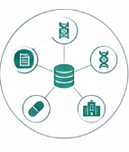


Introduction
Problem Definition
Motivation & Objectives
Implementation
Architecture
Methodology
Results
Future Work
References
Motivation
Why Drug Repurposing? Why Now?
1
Eroom’s Law
2
The Impossible Equation
3
The Silent Tragedy
R&D COST TO DEVELOP A NEW DRUG
The Inverse of Moore’s Law: Drug development costs double every 9 years.
7,000+ Rare Diseases affect millions globally.
~15 YEARS
~$1.4B
95% have no FDA-approved treatment.
Key Challenge: R&D cost is skyrocketing.
High Cost & Risk: long development time and high R&D spend.
1970 2020
Solution: Drug repurposing
4
Serendipity vs. Methodology
5
The Data Silo Dilemma
THE PAST
THE PRESENT
Successes happened by accident.
AI + Big Data enable systematic, intentional drug discovery.
90% of biomedical data is newly generated but isolated in silos. Need: a unified framework to unlock medical breakthroughs and stop data waste.
VS.
AI + Graph Networks + Unified Data
= A new paradigm for faster, smarter, and more equitable drug discovery.

Slide 9
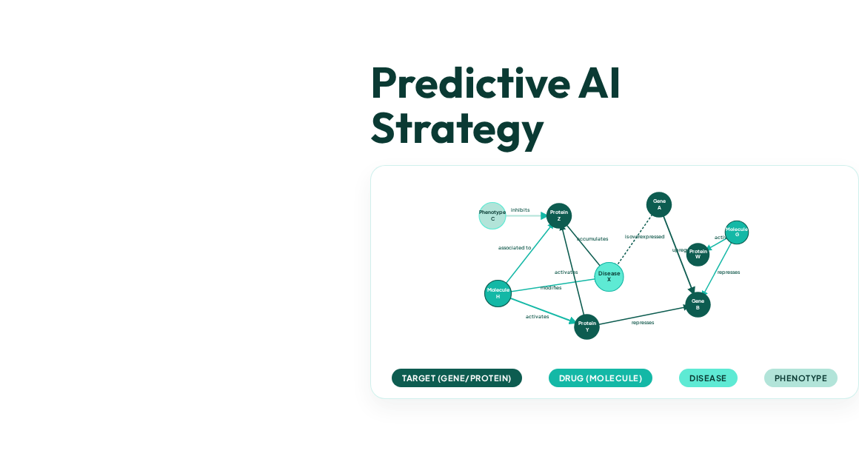

Introduction
Problem Definition
Motivation & Objectives
Implementation
Architecture
Methodology
Results
Future Work
References
Predict Missing Links
Identifying undocumented relationships between biological nodes.
Predict Drug-Disease Pairs
Discovering novel indications for existing pharmacological agents.
Efficiency
Drastically reduce the time and cost associated with de novo drug development.

Slide 10
Agenda
Introduction
Problem Definition
Motivation & Objectives
Implementation
Architecture
Methodology
Results
Future Work
References
Implementation

Slide 11






















Introduction
Problem Definition
Motivation & Objectives
Implementation
Architecture
Methodology
Results
Future Work
References
Technologies & Tools
Language & Core Libraries
Deep Learning & GNNs
FRAMEWORK & MODULES
ARCHITECTURES & CLASSES
XAI & GPU Acceleration
Machine Learning & Embeddings
EXPLAINABLE AI (XAI)
HARDWARE ACCELERATION

Slide 12



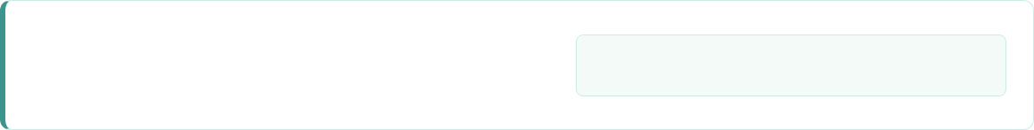

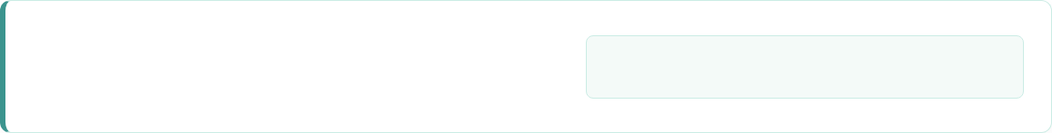
Introduction
Problem Definition
Motivation & Objectives
Implementation
Architecture
Methodology
Results
Future Work
References
Evaluation Metrics
AUC-ROC
Measures the model's overall ability to distinguish between distinct positive and negative classes across all classification thresholds.
AUC-PR
Provides a more informative metric for highly imbalanced datasets by examining the direct trade-off between Precision and Recall.
Accuracy
The proportion of correctly classified drug-disease pairs evaluated at the baseline 0.5 classification decision threshold.

Slide 13
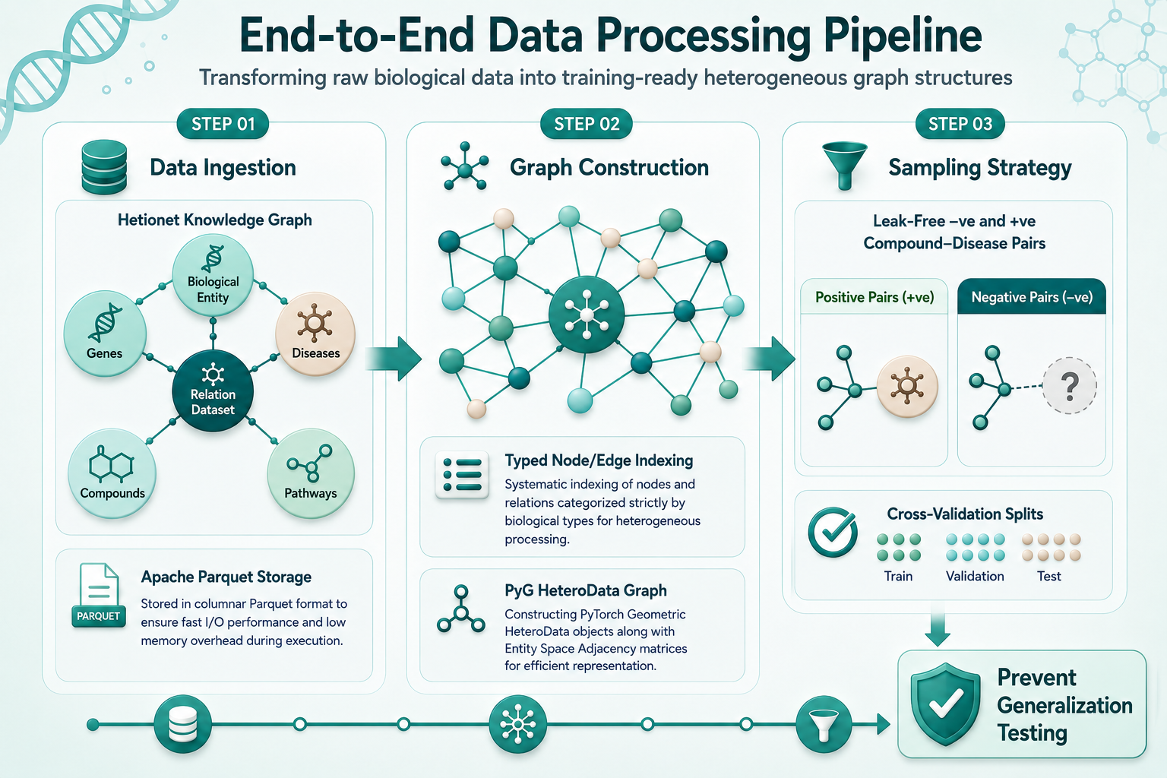








Introduction
Problem Definition
Motivation & Objectives
Implementation
Architecture
Methodology
Results
Future Work
References
End-to-End Data Processing Pipeline
Transforming raw biological data into training-ready heterogeneous graph structures
Data Ingestion
Graph Construction
Sampling Strategy
Hetionet Knowledge Graph
Typed Node/Edge Indexing
Leak-Free Pair Sampling
Comprehensive biological entity & relation dataset integrating genes, diseases, compounds, and pathways.
Systematic indexing of nodes and relations categorized strictly by biological type for heterogeneous processing.
Rigorous positive & negative Compound–Disease pair sampling engineered specifically to prevent data leakage.
Apache Parquet Storage
PyG HeteroData Graph
Cross-Validation Ready
Stored in columnar Parquet format to ensure fast I/O performance and low memory overhead during execution.
Constructing PyTorch Geometric HeteroData objects along with SciPy Sparse Adjacency matrices for efficient representation.
Tailored sampling splits structured for multi-fold Cross-Validation, ensuring unbiased generalization testing.
Data Processing Pipeline Overview
Implementation Phase

Slide 14




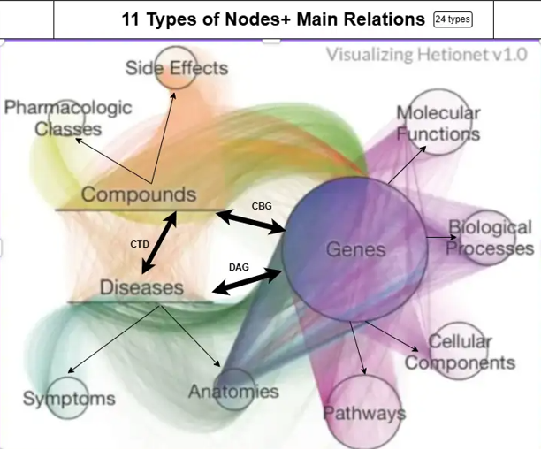

Introduction
Problem Definition
Motivation & Objectives
Implementation
Architecture
Methodology
Results
Future Work
References
Hetionet v1.0 Dataset Overview
29
47,000+
2.25M
Integrated Databases
Relationships
Drug Repurposing
Network Nodes
Documented interactions and therapeutic links across nodes.
.
Public biomedical databases merged into a single network.
Heterogeneous biological concepts and entities connected.
Biomedical Entities (11 Types)

Slide 15


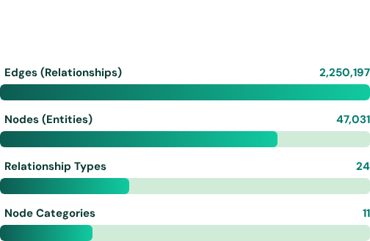



Introduction
Problem Definition
Motivation & Objectives
Implementation
Architecture
Methodology
Results
Future Work
References
Architecture & Benchmark Results
What is Hetionet?
Dataset Scale & Metrics
•
Heterogeneous Network (HetNet): Integrates multi-type nodes and relationships.
Logarithmic breakdown of graph components in Hetionet v1.0:
•
Graph-Based Dataset: Built and queried using Neo4j graph database.
Integrated Data Sources
Constructed from 29 leading public repositories:
Drug-Disease Benchmark
755
29,044
Evaluated prediction accuracy for "whether a drug can treat a disease":
Positive Treatments
Negative Pairs

Slide 16
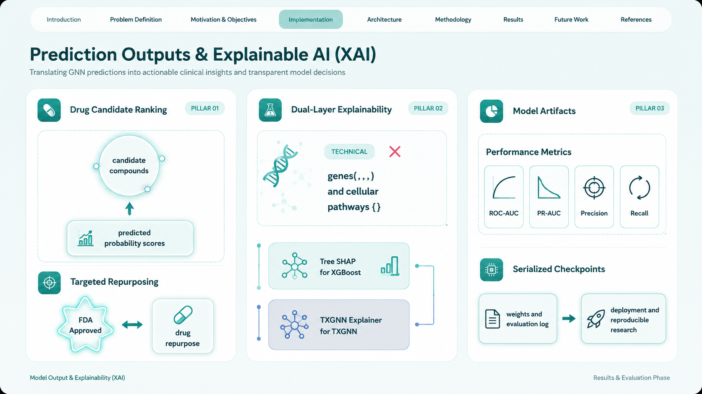




Introduction
Problem Definition
Motivation & Objectives
Implementation
Architecture
Methodology
Results
Future Work
References
Prediction Outputs & Explainable AI (XAI)
Translating GNN predictions into actionable clinical insights and transparent model decisions
Drug Candidate Ranking
Dual-Layer Explainability
Model Artifacts
get_top_drugs()
Biological Evidence
Performance Metrics
Ranks potential candidate compounds for any queried disease based on predicted probability scores.
Metapath lookup identifying shared genes (, , ) and cellular pathways ().
Automated generation of ROC and Precision-Recall (PR) curves alongside granular classification reports.
Targeted Repurposing
Model Interpretability
Serialized Checkpoints
Identifies high-confidence FDA-approved candidates to streamline drug discovery for pharmacological research.
TreeSHAP feature importance paired with attention-based graph mask explanations via .
Fully serialized model weights and evaluation logs ready for deployment and reproducible research.
Model Output & Explainability (XAI)
Results & Evaluation Phase

Slide 17
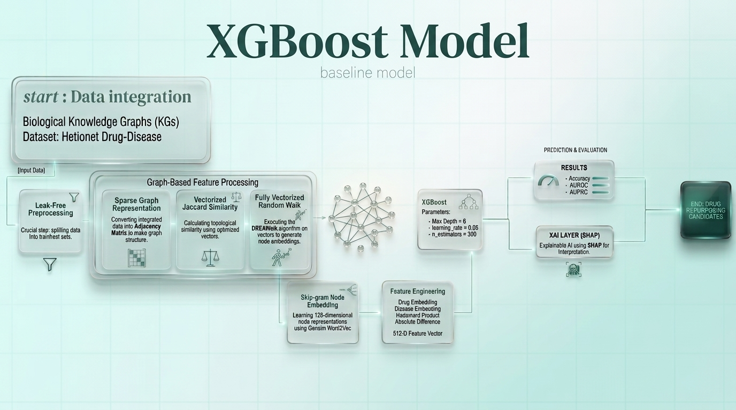

Slide 18
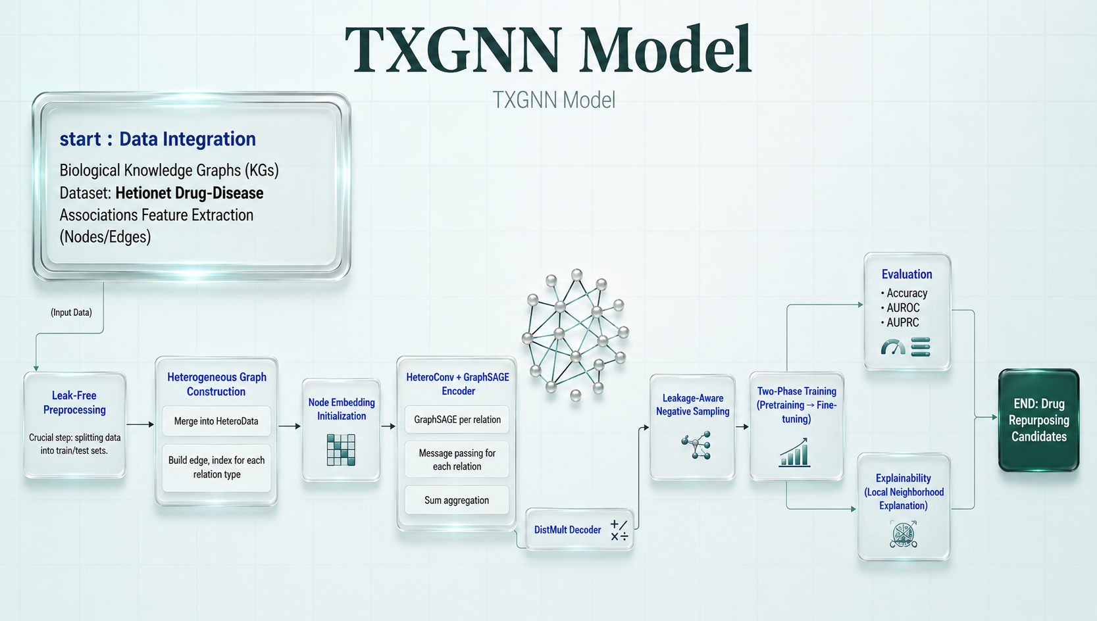
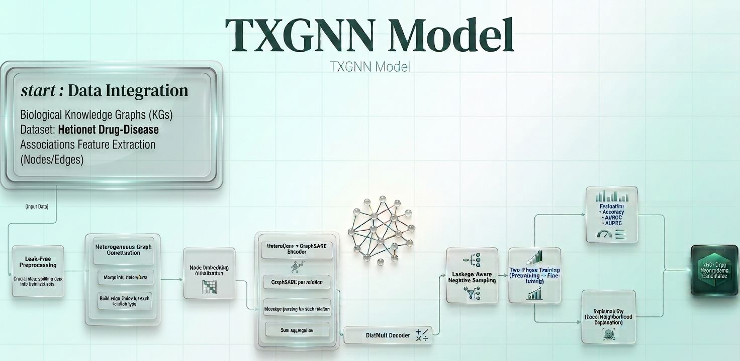

Slide 19
Agenda
Introduction
Problem Definition
Motivation & Objectives
Implementation
Architecture
Methodology
Results
Future Work
References
Architecture

Slide 20
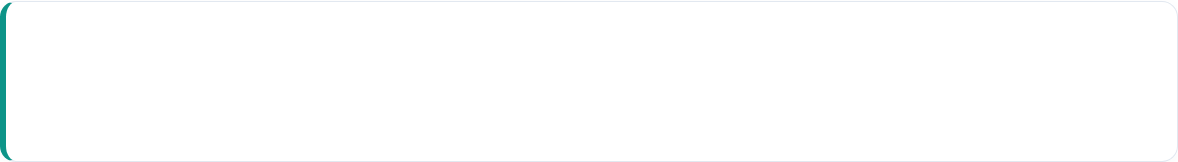
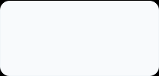
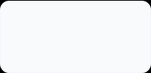


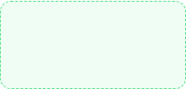
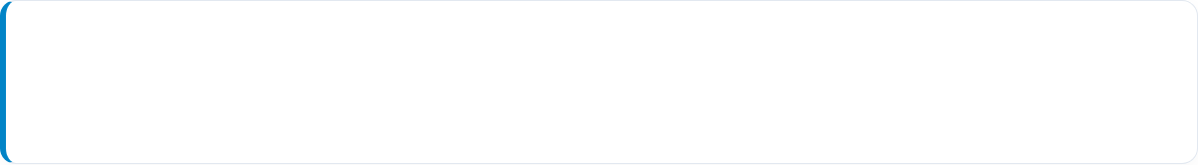
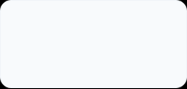
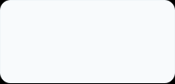

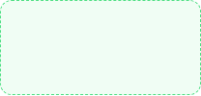
Introduction
Problem Definition
Motivation & Objectives
Implementation
Architecture
Methodology
Results
Future Work
References
Dual-Branch Model Pipelines
TxGNN Execution Pipeline
INPUT DATA
EMBEDDINGS
LINK PREDICTION
EVALUATION
OUTPUT ARTIFACT
Hetionet KG
2× GNN Layers
DistMult Scorer
Stratified 5-Fold
Probabilities
Random Walk + XGBoost Pipeline
INPUT GRAPH
RANDOM WALKS
CLASSIFICATION
EVALUATION
OUTPUT ARTIFACT
SparseGraph
Jaccard → W2V
XGBoost Model
Leak-Free 10-Fold
Predictions

Slide 21






Introduction
Problem Definition
Motivation & Objectives
Implementation
Architecture
Methodology
Results
Future Work
References
Ensemble & Explainability Layer
1. Predictions Merge
2. Meta-Ensemble
3. Dual Explainability
Out-of-fold prediction CSVs from Branch A and Branch B are merged on (compound_id, disease_id, fold) ensuring strict validation alignment.
Compares Weighted Average, Stacked Logistic Regression, and Stacked XGBoost (nested-tuned via leave-one-fold-out evaluation).
XGBoost: TreeSHAP + Metapath evidence ranking. TxGNN : Attention-based TxGNN_Explainer mechanism.

Slide 22
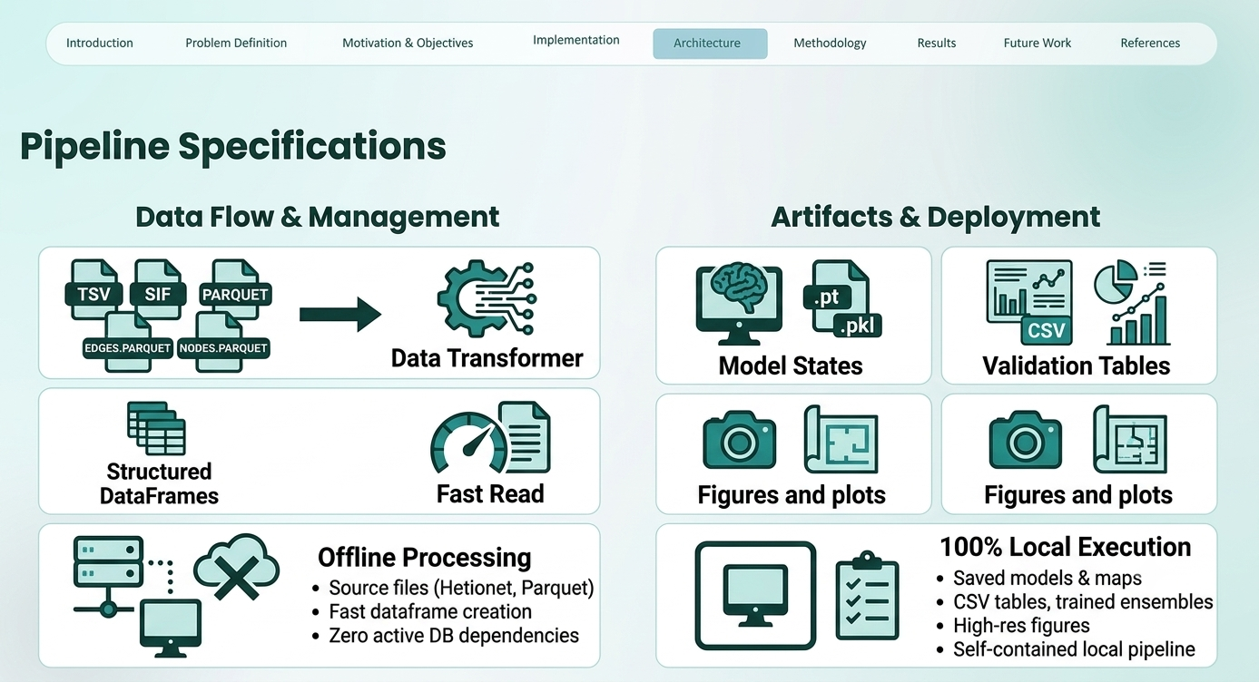


Introduction
Problem Definition
Motivation & Objectives
Implementation
Architecture
Methodology
Results
Future Work
References
Pipeline Specifications
Data & Storage Layer
Persistence & Infrastructure
Primary Source: Hetionet Knowledge Graph loaded from TSV/SIF source files into optimized Parquet tables (nodes.parquet, edges.parquet).
Model Checkpoints: PyTorch model states saved as .pt files; entity ID mappings stored as .pkl.
Artifact Exports: Statistical validation tables as .csv and trained ensembles saved via joblib.
Memory Efficiency: Fast local graph deserialization into structured tabular DataFrames for both branches.
Publication Figures: High-resolution architectural & performance plots generated.
Environment: Standalone offline execution pipeline with zero dependency on active DB servers.
Deployment Profile: 100% self-contained local research execution (No API server / web backend required).

Slide 23
Agenda
Introduction
Problem Definition
Motivation & Objectives
Implementation
Architecture
Methodology
Results
Future Work
References
Methodology

Slide 24
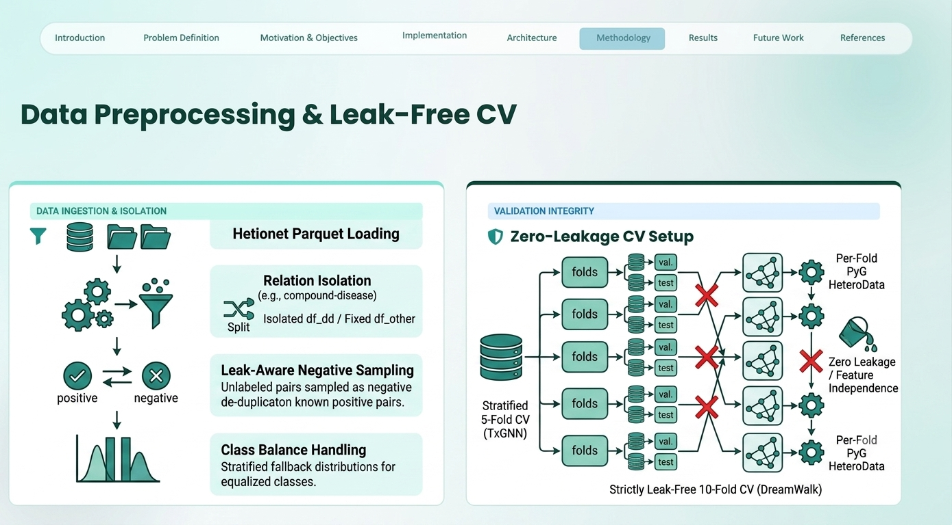


Introduction
Problem Definition
Motivation & Objectives
Implementation
Architecture
Methodology
Results
Future Work
References
Data Preprocessing & Leak-Free CV
Data Preprocessing Pipeline
Zero-Leakage CV Setup
Hetionet Parquet Loading: Graph nodes/edges indexed by entity type directly from local Parquet storage.
Branch A (TxGNN): Stratified 5-Fold CV on df_dd; held-out test edges split 50/50 for validation & testing.
Relation Isolation: Compound–Disease edges (df_dd) isolated for training; all other relations (df_other) held fixed.
Branch B (DreamWalk): Strictly leak-free 10-Fold Cross-Validation execution.
Leak-Aware Negative Sampling: Unlabeled pairs sampled as negative controls with strict de-duplication against known positive pairs.
Per-Fold Graph Rebuild: Brand-new PyG HeteroData graphs and SparseGraph CSR matrices instantiated from scratch every fold.
Class Balance Handling: Stratified fallback mechanisms for rare relation classes with fewer than 5 members.
Feature Independence: Zero similarity/walk leakage between training and evaluation folds.

Slide 25
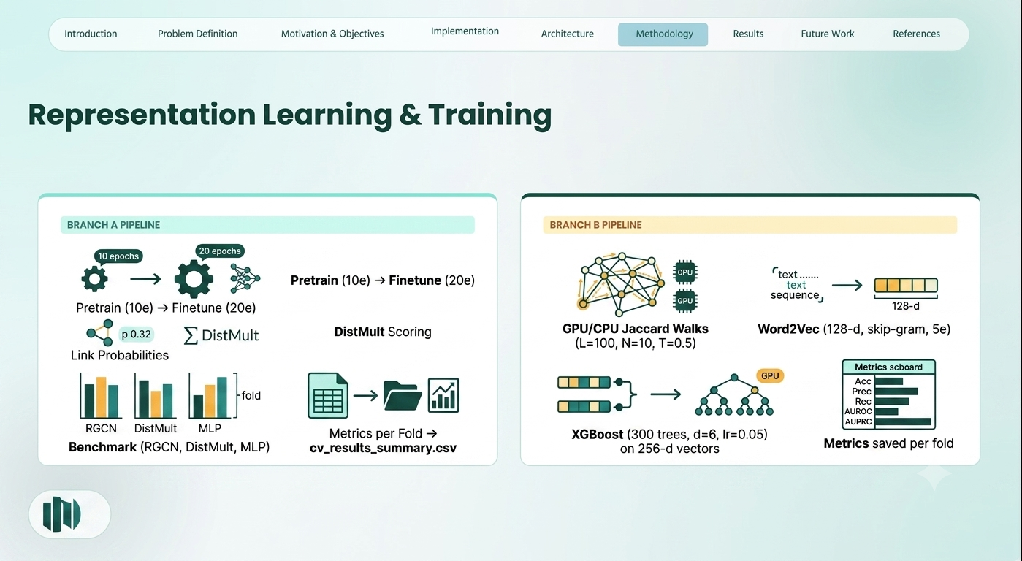
Introduction
Problem Definition
Motivation & Objectives
Implementation
Architecture
Methodology
Results
Future Work
References
Representation Learning & Training
GNN Representation & Pretraining
Random Walks & XGBoost
TxGNN_PyG Architecture: Pretrain stage (10 epochs) → Finetune stage (20 epochs) utilizing BCEWithLogitsLoss.
Similarity-Guided Walks: GPU/CPU Jaccard walks (length=100, num_walks=10, teleport=0.5) per fold.
Batch & Optimizer: Batch size 512 with Adam optimizer evaluating link probabilities via DistMult scoring.
Word2Vec Embeddings: Skip-gram model trained on walk sequences (128-d, window=5, 5 epochs).
Baseline Benchmark: RGCN, DistMult (Distance Multilinear), and MLP baselines trained for 30 epochs per fold under identical conditions.
XGBoost Classifier: Trained on 256-d concatenated pair vectors using GPU hist method (300 trees, depth=6, lr=0.05).
Performance Tracking: Fold metrics summarized across folds into cv_results_summary.csv.
Evaluation Metrics: Accuracy, Precision, Recall, F1, AUROC, and AUPRC saved per fold.

Slide 26






Introduction
Problem Definition
Motivation & Objectives
Implementation
Architecture
Methodology
Results
Future Work
References
Meta-Ensembling & Statistical Rigor
1. Aligned Merging
2. Meta-Learner Tuning
3. Bootstrap Validation
Out-of-fold predictions from Branch A and Branch B are merged on (compound_id, disease_id, fold) across 760 aligned pair samples.
Compares Weighted Average, Stacked Logistic Regression, and Stacked XGBoost with inner 5-fold GridSearchCV evaluated leave-one-fold-out.
Paired bootstrap significance testing (2,000 resamples) for AUROC 95% CIs + Youden's-J ROC optimal decision threshold selection.

Slide 27
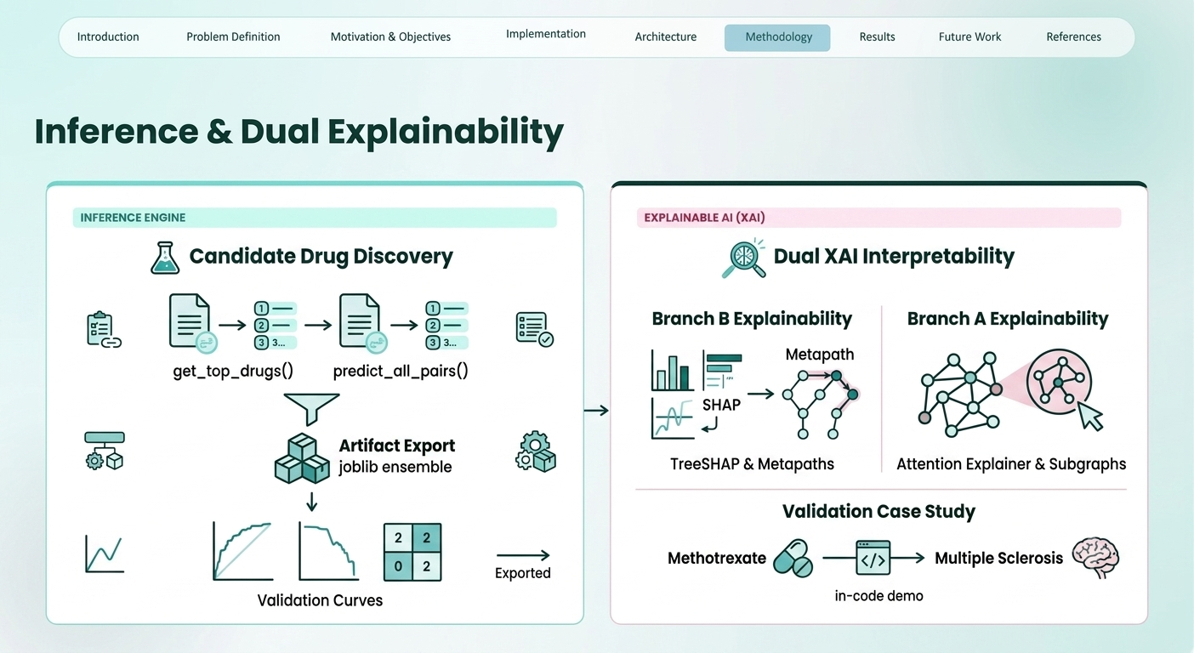


Introduction
Problem Definition
Motivation & Objectives
Implementation
Architecture
Methodology
Results
Future Work
References
Inference & Dual Explainability
Candidate Drug Discovery
Dual XAI Interpretability
Screening Pipeline: get_top_drugs() and predict_all_pairs() generate ranked therapeutic candidate lists.
Branch B Explainability: 7 TreeSHAP summary/bar plots + metapath evidence extraction for random walk paths.
Artifact Export: Final ensemble saved via joblib along with optimal decision thresholds and metadata.
Branch A Explainability: Attention-based TxGNN_Explainer isolating graph subgraph evidence.
Publication Plots: Publication-quality ROC/PR curves and confusion matrices exported .
Validation Case Study: Dual XAI demonstrated in-code on Methotrexate → Multiple Sclerosis pair.

Slide 28
Agenda
Introduction
Problem Definition
Motivation & Objectives
Implementation
Architecture
Methodology
Results
Future Work
References
Results

Slide 29






Introduction
Problem Definition
Motivation & Objectives
Implementation
Architecture
Methodology
Results
Future Work
References
Results & Output Architecture
1. Quantitative Metrics Suite
2. Aligned Evaluation Dataset
3. Automated Artifact Outputs
Standardized computation of Accuracy, Precision, Recall, F1-Score, AUROC, and AUPRC across both per-fold execution and aggregate Mean ± Std summaries.
Features 760 aligned compound-disease pairs across 10 folds. This focused sample size directly motivates our use of 2,000-resample paired bootstrap testing.
Generates cv_per_fold_results.csv, cv_results_summary.csv, high-resolution ROC/PR curves, and prediction score distribution plots .

Slide 30



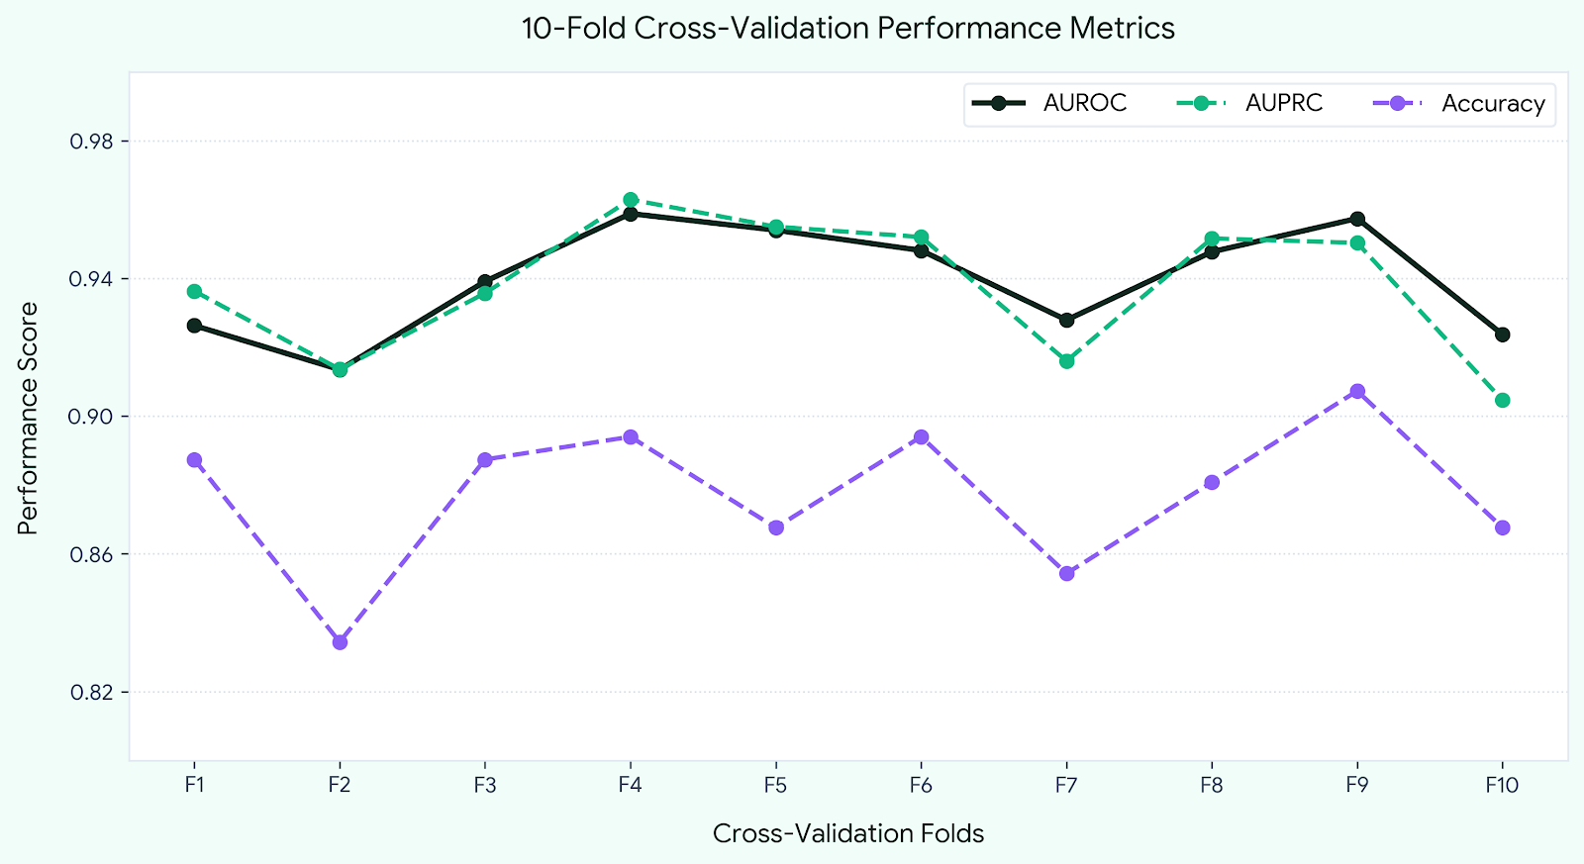
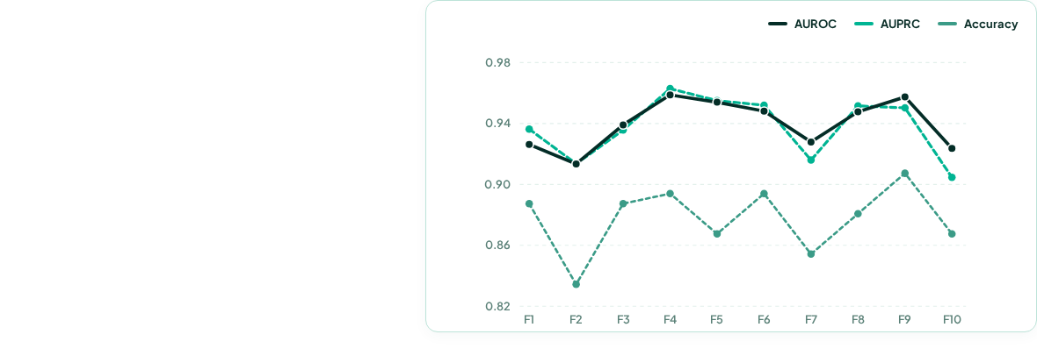

Introduction
Problem Definition
Motivation & Objectives
Implementation
Architecture
Methodology
Results
Future Work
References
DREAMwalk — AI-Powered Drug Repurposing Engine (10-Fold CV)
NODES IN GRAPH
EDGES
DRUG–DISEASE PAIRS SCORED
47,031
2,250,197
209,168
Fold | AUROC | AUPRC | Acc
Fold 1 | 0.9263 | 0.9363 | 0.8874
Fold 2 | 0.9135 | 0.9136 | 0.8344
Fold 3 | 0.9391 | 0.9357 | 0.8874
Fold 4 | 0.9588 | 0.9629 | 0.8940
Fold 5 | 0.9540 | 0.9550 | 0.8676
Fold 6 | 0.9481 | 0.9520 | 0.8940
Fold 7 | 0.9279 | 0.9160 | 0.8543
Fold 8 | 0.9477 | 0.9516 | 0.8808
Fold 9 | 0.9574 | 0.9503 | 0.9073
Fold 10 | 0.9237 | 0.9046 | 0.8676
Average | 0.9396 | 0.9378 | 0.8775

Slide 31
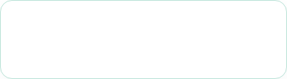
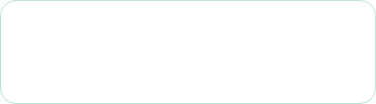

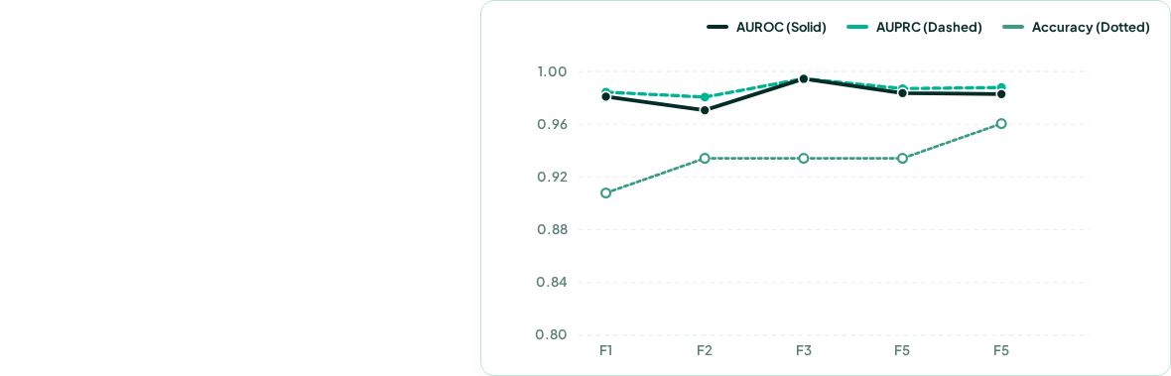

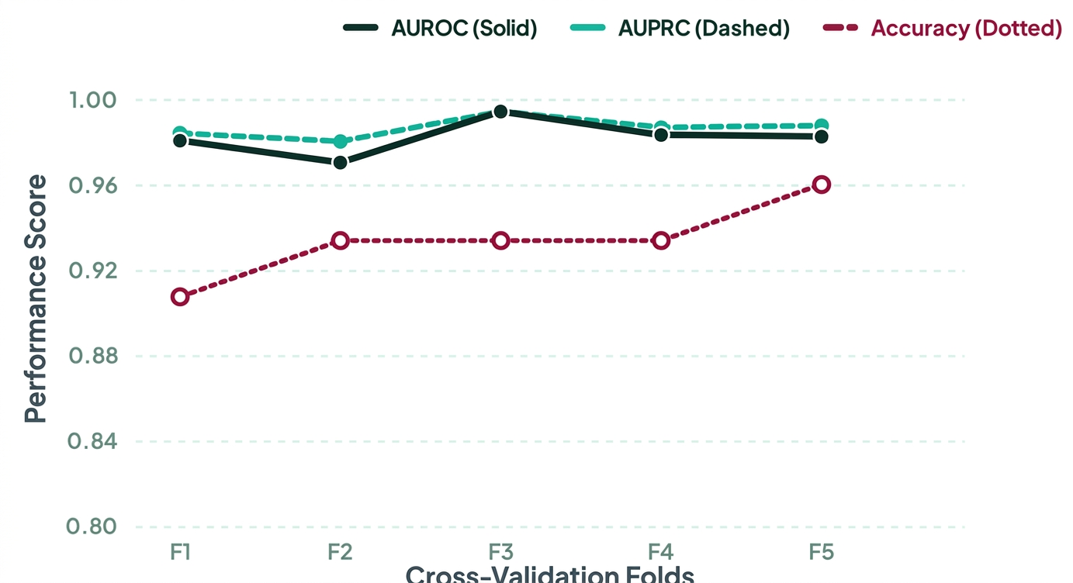
Introduction
Problem Definition
Motivation & Objectives
Implementation
Architecture
Methodology
Results
Future Work
References
TxGNN — AI-Powered Drug Repurposing Engine (5-Fold CV)
TRAIN / VAL / TEST DD
MEAN AUROC
MEAN AUPRC
916 / 114 / 115
0.9825
0.9869
1,145 Total Drug-Disease Pairs
(+/- 0.0084 Standard Deviation)
(+/- 0.0051 Standard Deviation)
Fold | AUROC | AUPRC | Acc
Fold 1 | 0.9810 | 0.9844 | 0.9079
Fold 2 | 0.9707 | 0.9807 | 0.9342
Fold 3 | 0.9945 | 0.9946 | 0.9342
Fold 4 | 0.9837 | 0.9871 | 0.9342
Fold 5 | 0.9829 | 0.9879 | 0.9605
Average | 0.9825 | 0.9869 | 0.9342

Slide 32
Introduction
Problem Definition
Motivation & Objectives
Implementation
Architecture
Methodology
Results
Future Work
References
Single-Branch Performance
GNN Benchmarking (TxGNN)
Embedding & Boosting Metrics
Per-Fold Tracking: Fold-by-fold AUROC & AUPRC scores recorded for TxGNN and 3 baseline architectures (RGCN, DistMult (Distance Multilinear), MLP).
10-Fold CV Summaries: Per-fold evaluation metrics saved for the DreamWalk-XGBoost pipeline across all 10 folds.
Summary Deliverable: Exported cv_results_summary.csv containing Mean ± Std across 5 cross-validation folds.
Score Distribution Analysis: Generates prediction-score distribution plots to evaluate positive vs. negative pair margin separation.
Visual Artifact: Automated cross-validation comparison bar chart displaying explicit standard deviation error bars.
Out-of-Fold Export: Generates aligned probability predictions in dreamwalk_predictions.csv for downstream ensembling.

Slide 33

Introduction
Problem Definition
Motivation & Objectives
Implementation
Architecture
Methodology
Results
Future Work
References
Meta-Ensemble & Significance
Bootstrap Confidence Intervals
Thresholding & Calibration
Evaluated Model Suite: DreamWalk-XGBoost alone, TxGNN alone, Weighted Average, Stacked Logistic Regression, and Stacked XGBoost.
Optimal Decision Boundary: Full classification reports computed at standard 0.5 threshold vs. Youden's-J optimal threshold.
Non-Parametric CIs: Summary table reporting 95% Bootstrap CIs for AUROC and AUPRC across 2,000 resamples.
Diagnostic Curves: Generates paired ROC, Precision-Recall, and probability calibration curves.
Paired Hypothesis Testing: Evaluates mean AUROC difference, confidence intervals, and p-values vs. the best single standalone model.
Error Analysis Breakdown: Categorizes specific pair instances corrected by the ensemble vs. hard cases missed by both branches.

Slide 34



Introduction
Problem Definition
Motivation & Objectives
Implementation
Architecture
Methodology
Results
Future Work
References
XAI & Case Study Validation
Targeted Query Execution
Multi-Level Mechanistic Insights
The explainability framework includes a code-level execution pipeline designed for target drug-disease pairs:
Branch B SHAP & Metapaths: Computes 7 TreeSHAP summary/bar plots and ranks top metapath walk paths contributing to the prediction.
Branch A Subgraph Isolation: Attention-based TxGNN_Explainer highlights the surrounding heterogeneous graph edges.
Biomedical Transparency: Provides clinicians and researchers with interpretable biological rationale behind candidate predictions.
Serves as a real, named-pair proof of concept for biomedical evidence extraction.

Slide 35
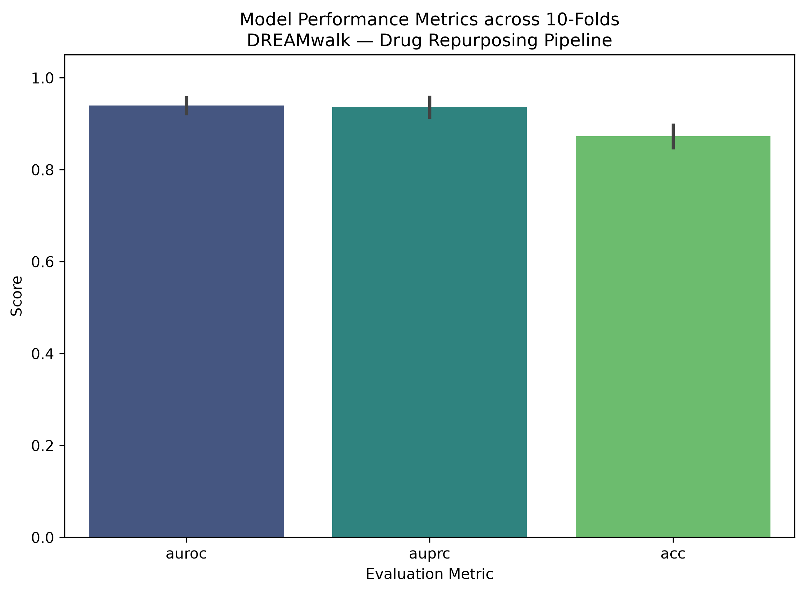
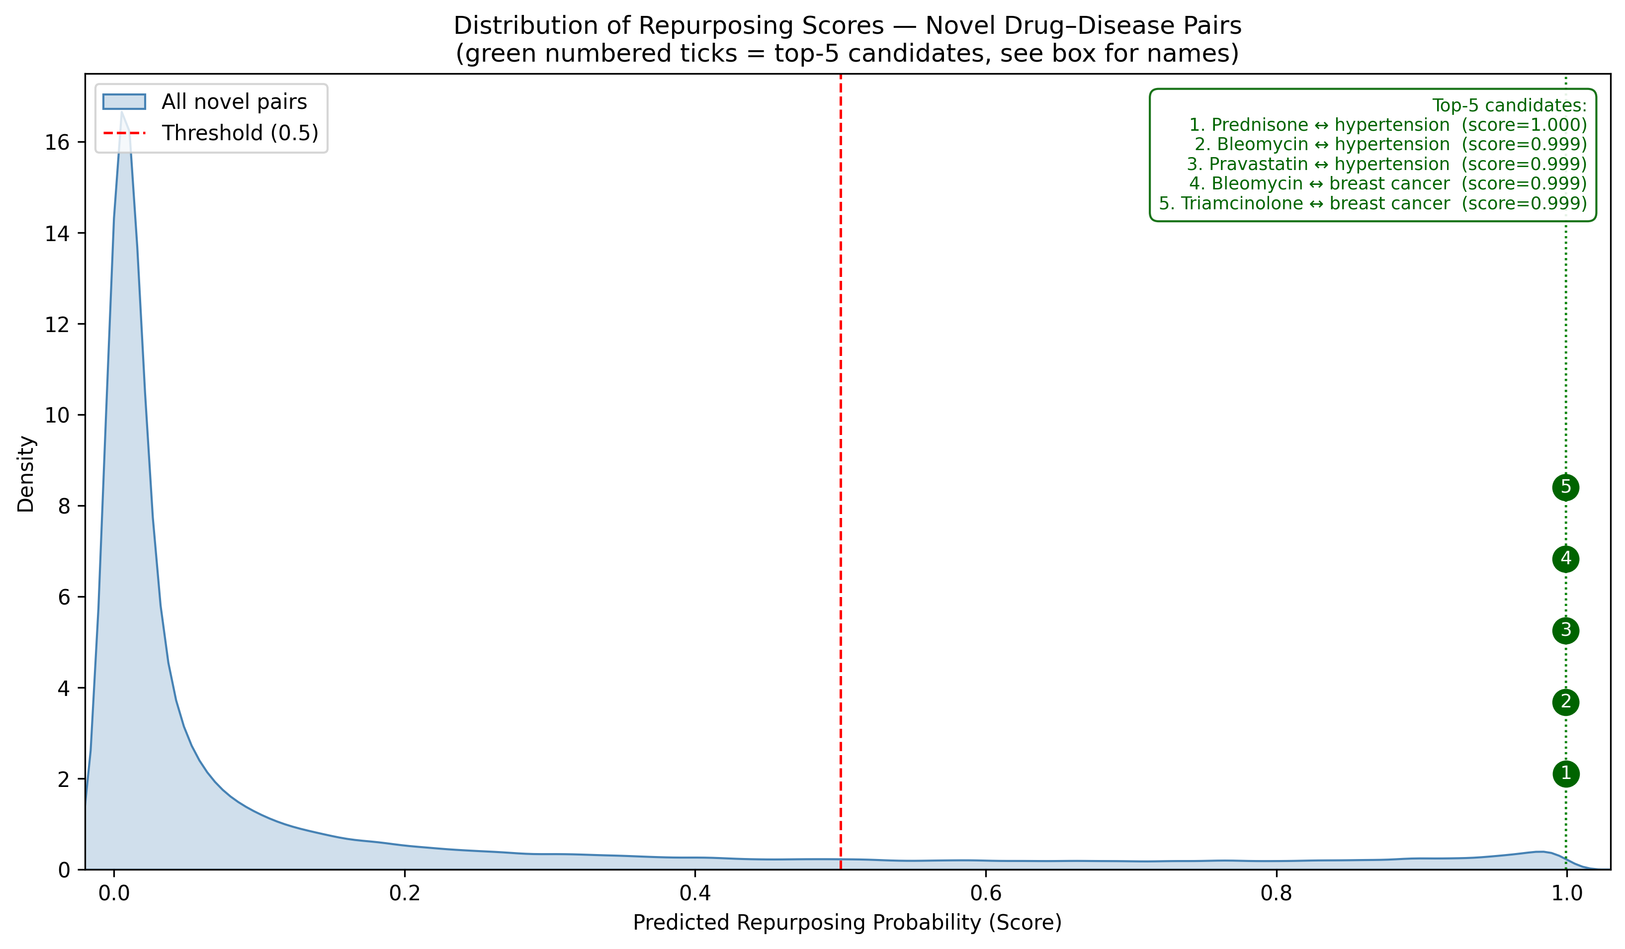
Introduction
Problem Definition
Motivation & Objectives
Implementation
Architecture
Methodology
Results
Future Work
References
XAI & Case Study Validation

Slide 36
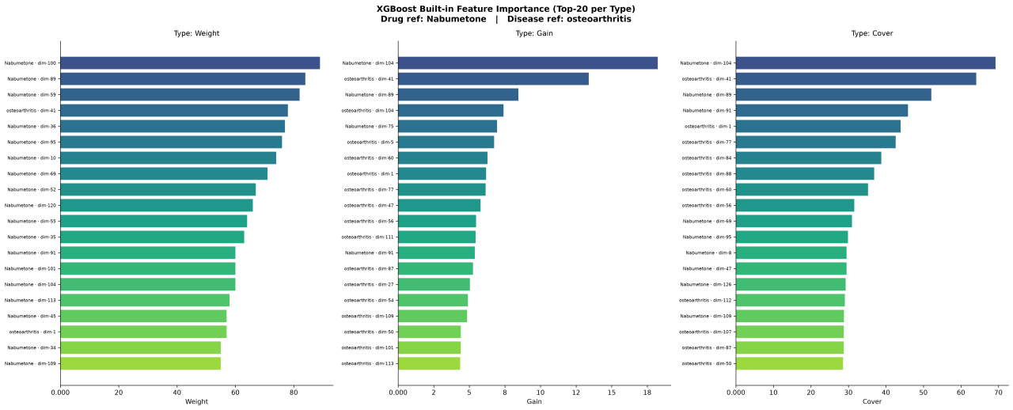
Introduction
Problem Definition
Motivation & Objectives
Implementation
Architecture
Methodology
Results
Future Work
References
XAI & Case Study Validation

Slide 37
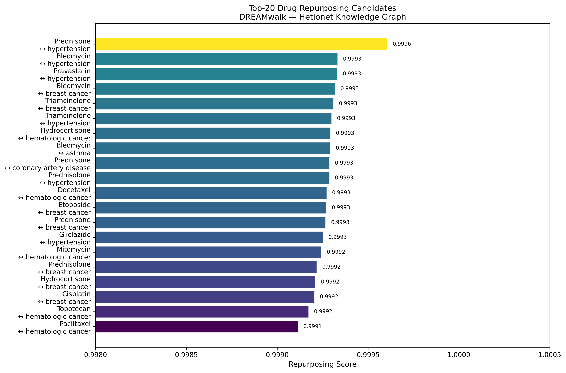
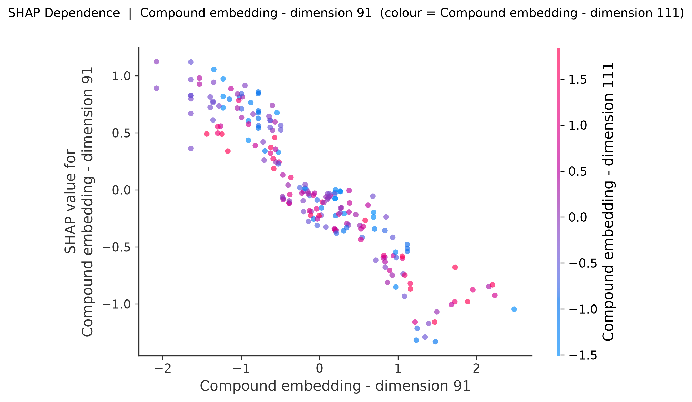
Introduction
Problem Definition
Motivation & Objectives
Implementation
Architecture
Methodology
Results
Future Work
References
XAI & Case Study Validation

Slide 38


Introduction
Problem Definition
Motivation & Objectives
Implementation
Architecture
Methodology
Results
Future Work
References
System & Validation Limitations
XAI Resolution & Aggregation
CV & Alignment Constraints
Latent Space SHAP: TreeSHAP operates on latent embedding dimensions rather than direct biological features (paired with Metapaths to compensate).
Single Edge CV Coverage: Cross-validation covers Compound–Disease edges only; all other Hetionet relations remain fixed.
Small Ensemble Test Set: 760 aligned pairs mandate statistical significance testing over face-value metrics.
Single-Fold Post-Hoc Run: Explanations (TxGNN_Explainer & SHAP/Metapath) are run post-hoc on the last fold's trained model.
Upstream File Dependency: Prediction CSVs require strict structural alignment on (compound_id, disease_id, fold) checked only at runtime.
Lack of Fold Aggregation: Interpretability outputs represent single instance snapshots rather than cross-fold averages.

Slide 39





Introduction
Problem Definition
Motivation & Objectives
Implementation
Architecture
Methodology
Results
Future Work
References
Strategic Future Roadmap
1. End-to-End Execution
2. Config & CLI Pathing
Execute both pipelines & ensemble script completely to populate all metric tables and ROC/PR plots with real, fully reproducible data.
Externalize file paths into YAML/JSON configuration files or CLI flags to eliminate hardcoded local paths and maximize cross-platform portability.
3. Structural Validation & Multi-Edge CV
4. Cross-Fold Aggregated XAI
Introduce shared Run IDs to structurally prevent prediction CSV misalignment and expand cross-validation coverage across all Hetionet relation types.
Aggregate SHAP feature importance vectors, metapath frequencies, and attention weights across all folds rather than relying on single post-hoc runs.

Slide 40
Agenda
Introduction
Problem Definition
Motivation & Objectives
Implementation
Architecture
Methodology
Results
Future Work
References
Future Work

Slide 41
Introduction
Problem Definition
Motivation & Objectives
Implementation
Architecture
Methodology
Results
Future Work
References
FUTURE WORK
01
02
03
04
EXPAND DATA
ADVANCED GNNs
DYNAMIC KG & RAG-BASED EVIDENCE RETRIEVAL
EXPERIMENTAL VALIDATION
EXPAND DATA
More biomedical databases beyond Hetionet
Integrate additional biomedical databases beyond Hetionet to increase graph coverage and capture more drug–disease relationships.
More heterogeneous architectures powerful
Explore more advanced Heterogeneous GNN architectures and attention mechanisms to improve representation learning and prediction performance.
(RAG) pipelines
Continuously update the knowledge graph and extract real-time biomedical evidence from PubMed using advanced RAG pipelines
Validate top-ranked novel candidates
Prioritize the highest-ranked novel drug–disease candidates for literature-based, preclinical, and eventually clinical validation.

Slide 42
Agenda
Introduction
Problem Definition
Motivation & Objectives
Implementation
Architecture
Methodology
Results
Future Work
References
References

Slide 43















Introduction
Problem Definition
Motivation & Objectives
Implementation
Architecture
Methodology
Results
Future Work
References
References
Biomedical knowledge graph learning for drug repurposing by extending guilt-by-association to multiple layers
Drug repositioning with adaptive graph convolutional networks
Guilt-by-Association
Adaptive Graph Networks
A novel efficient drug repurposing framework through drug-disease association data integration using convolutional neural networks
A foundation model for clinician-centered drug repurposing
Clinical Applications
Data Integration
deepDR: a network-based deep learning approach to in silico drug repositioning
Challenges and opportunities with drug repurposing: finding strategies to find alternative uses of therapeutics
Network Approaches
Expert Opinion on Drug Discovery
Drug Repo: a novel approach to repurposing drugs based on chemical and genomic features
Chemical Features

Slide 44

Thank you

